Slide 1
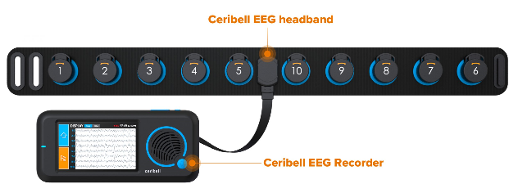
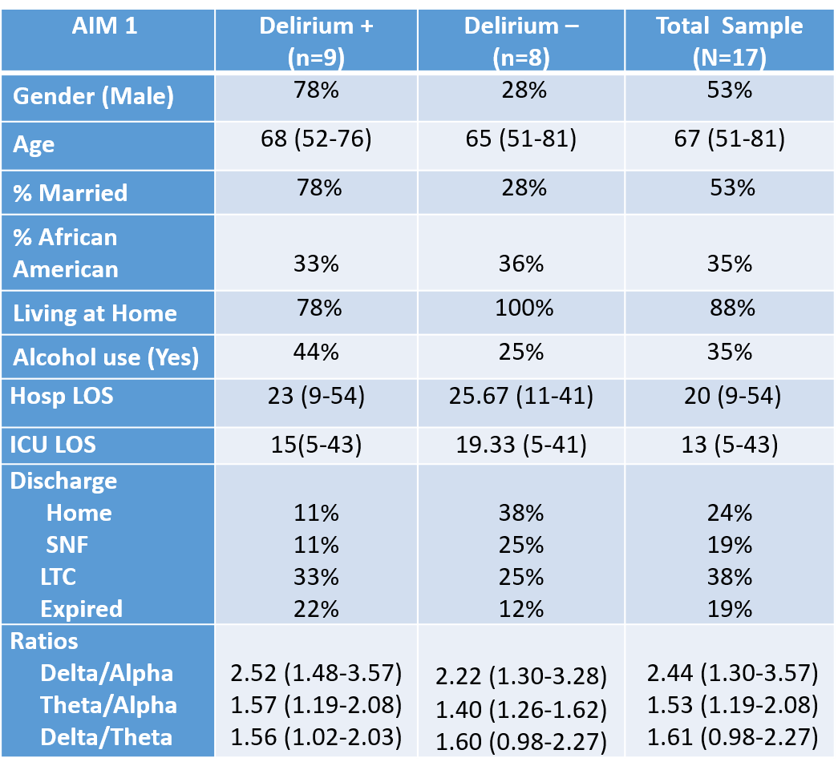
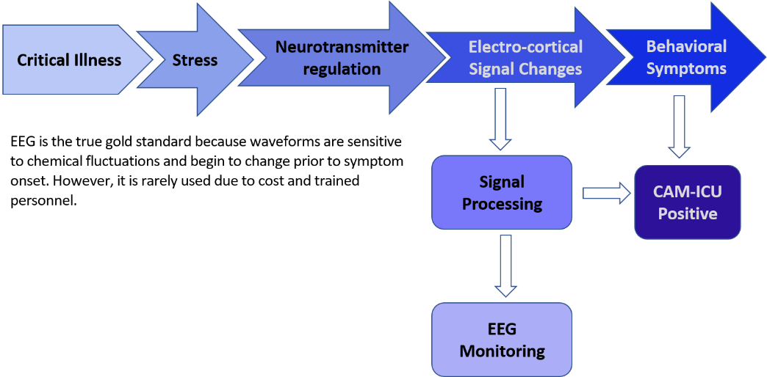




Exploring Rapid EEG for Delirium Detection
Malissa Mulkey, PhD, APRN, CCNS, CCRN, CNRN
Background
Delta/Theta Ratios
Delirium is synonymous with brain failure affecting 80% ICU patients and higher mortality within 1 year
Current assessment tools detect approximately 20% of ICU delirium
Delirium related biochemical derangements result in changes in electroencephalographic (EEG) followed by behavioral changes
EEG is the gold standard yet is not feasible
Prior research using 2-lead EEG show large difference between patients with & without delirium while discriminating delirium from other causes
Newer devices with more leads are handheld and able provide rapid signal processing
wakefulness
twilight sleep
References
Mulkey MA, Hardin SR, Munro CL, Everhart DE, Kim S, Schoemann AM, Olson DM. Methods of identifying delirium: A research protocol. Res Nurs Health. 2019 Aug;42(4):246-255. doi: 10.1002/nur.21953. Epub 2019 May 30. PMID: 31148216
Mulkey MA, Hardin SR, Olson DM, Munro CL. Pathophysiology Review: Seven Neurotransmitters Associated With Delirium. Clin Nurse Spec. 2018 Jul/Aug;32(4):195-211. doi: 10.1097/NUR.0000000000000384. PMID: 29878931.
van der Kooi AW, Zaal IJ, Klijn FA, et al. Delirium detection using EEG: What and how to measure. Chest. 2015;147(1):94-101.
deep sleep
Ceribell
Limitations
Rapid EEG using a handheld device
FDA approved for seizure monitoring in 2017
Uses headband to circumscribe the head to collect data from all 5 lobes of the brain
Has 10-leads and provides 8 EEG waveforms
96% sensitivity and 84% specificity
Only headband EEG product available
Single site
Small sample size
Two devices
Researcher availability to monitor
Obtaining LAR consent
COVID-19 pandemic ceased data collection early
Design & Methods
Prospective pilot proof of concept cohort study using a cross sectional design conducted at a NC academic medical center
Enrolled 17 critically ill adults (≥50 yrs old) requiring mechanical ventilation for >12 hrs
IRB approval obtained and legally authorized representatives provided written consent
Performed 2-hr EEG and delirium screens daily for up to 4 days or ICU discharge
EEGs were processed using higher order signal analysis and fieldtrip toolbox functionality
Advanced independent component analyses were performed to evaluate EEG waveform ratios in MatLab
Mixed models were performed to evaluate differences in delirium status while controlling for independent patient effects
Acknowledgement
CAM-ICU Delirium Screen
Conclusions
  East Carolina University, PhD program
  Indiana University School of Nursing, Post-Doctoral Fellowship
Designed for use with mechanically ventilate patients
When used by researchers, sensitivity and specificity are ~98%
Rapid EEG may be a viable option
Additional research with larger samples and exploration of other EEG methods of analyses are needed to determine benefit
Discussion
Implications for Practice
Funding
Evaluation using several models
Theta/alpha ratios were statistically significant with higher ratios in patients with delirium
Delta/alpha and Delta/theta ratios were approaching significance despite the small sample size
For now, nurses should continue using a well validated tool with frequent re-education to minimize practice drift
Combining CAM-ICU results with other screening methods and not discounting findings may further improve detection
  This study was fully funded by the following organizations:
  American Association of Critical Care Nurses
  American Association of Neuroscience Nurses
  Geriatric Advanced Practice Nurse Association

